Slide 1

C++ on small microcontrollers
Talk
Wouter van Ooijen MSc (ir)
Hogeschool Utrecht, Netherlands,
senior lecturer Computer Engineering
wouter.vanooijen@hu.nl
Meeting C++ Berlin 2015 : Embedded (& parallelism)

Slide 2

Just daydreaming….
I want to
Program small microcontrollers
Effectively
Without repeating myself
Better, I’d love to use your code!

Slide 3
Embedded – a meaning
Means:
part of something larger (not stand-alone)
subservient to that larger thing
with a dedicated task (not general-purpose).
Note that this does not imply a particular type of hardware or style of programming.
Often computer hardware is used for embedded systems that is the same or very similar to what is used on a desktop.

Slide 4
Embedded – some differences
The computer hardware is part of the product
The price of the hardware is reflected in the price of the product.
There is economic pressure to be efficient (use the cheapest posible hardware).
Often the ‘larger thing’ has (hard) real-time requirements.
The embedded system must (always) be fast enough.
Often the system is used to control real hardware.
➔ Failures have interesting consequences (up to loss of life).

Slide 5
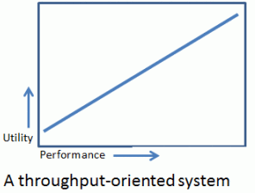
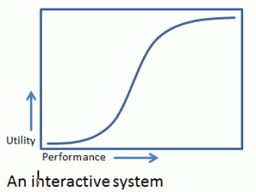
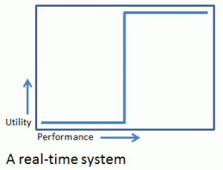
Real-Time
Means: utility depends critically on some timing parameter.
Variations (terms vary):
Soft real-time: usefulness degrades (rapidly)
Firm real-time: may occasionally be late or lower-quality

Slide 6

Soft real-time
usefulness degrades (rapidly) beyond the deadline
(if there was any to begin with…)

Slide 7
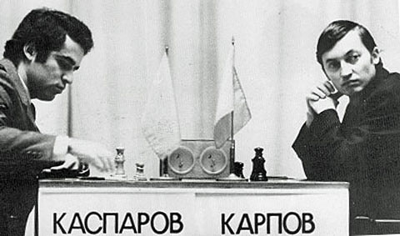
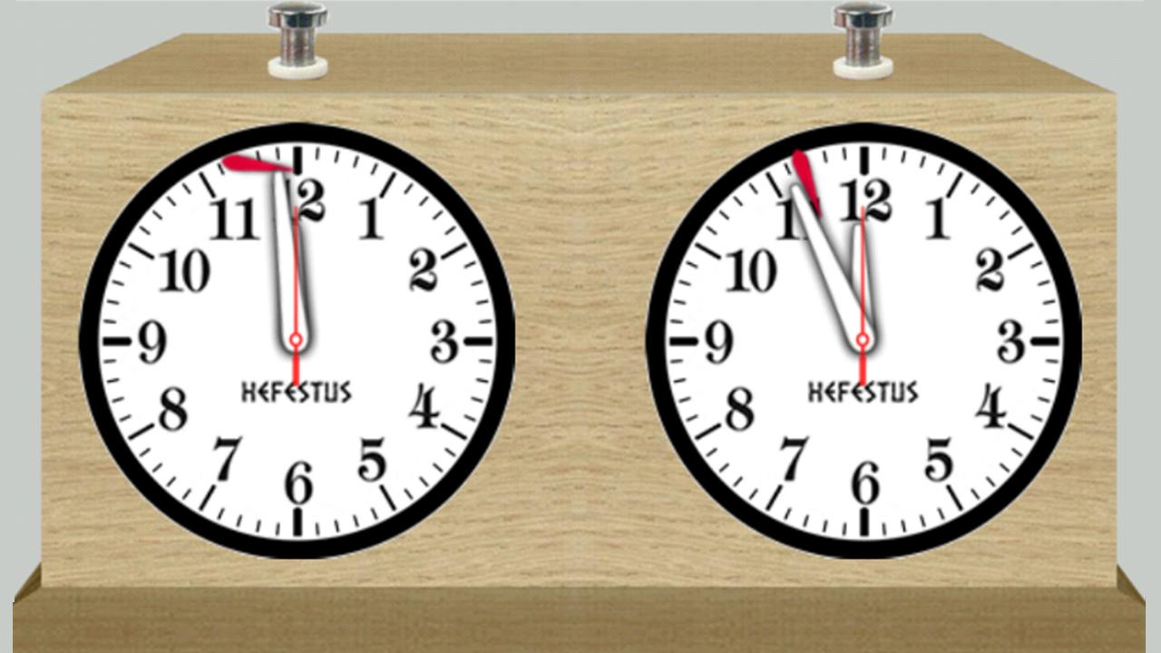
Firm real-time
If the perfect result can’t be calculated in time give what you have, but be on time!

Slide 8

Hard real-time (and mission-critical)
Late might even be worse than not at all…

Slide 9



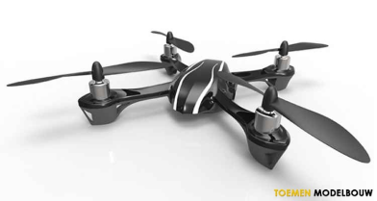
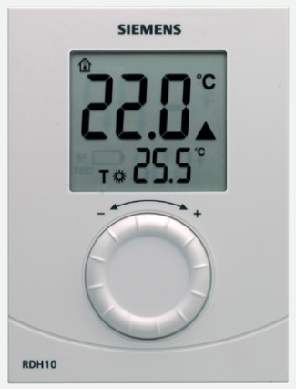

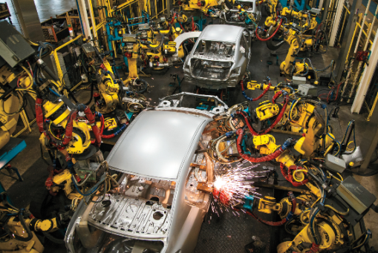


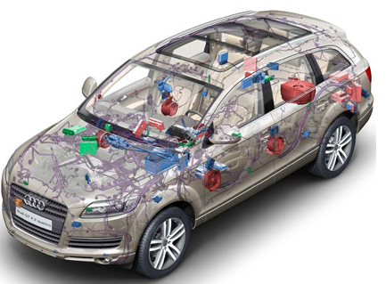
Embedded a wide range of seriousness
Consequently, a wide range of development styles: JBF*, Agile, prototyping, waterfall, …
* ”Jan Boere Fluitjes”: Dutch saying, meaning roughly ‘casual, with as little effort as possible’

Slide 10
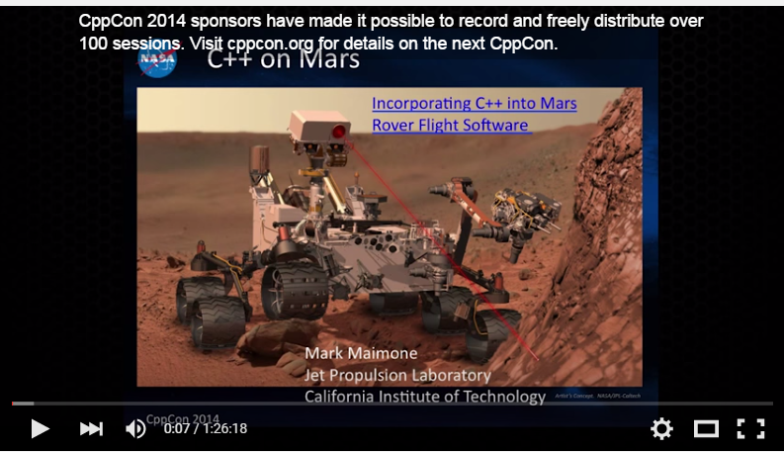
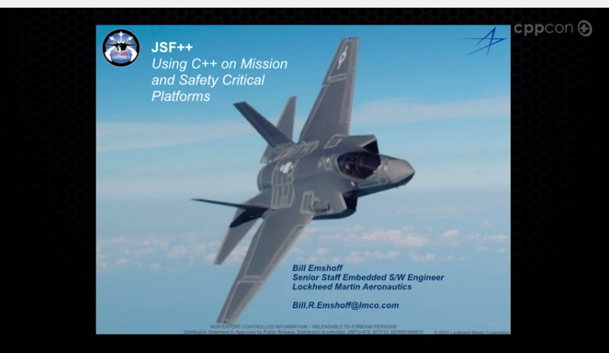
C++ in (very) serious embedded systems
CppCon 2014: Mark Maimone "C++ on Mars: Incorporating C++ into Mars Rover Flight Software"
CppCon2014: Bill Emshoff "Using C++ on Mission and Safety Critical Platforms"

Slide 11
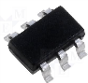
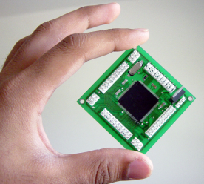
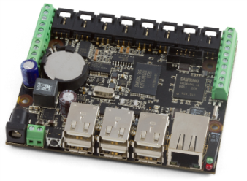
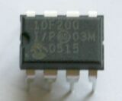
Embedded a wide range of hardware capabilities
1Kb
1Mb
1Gb
4-bit
64-bit
8-bit : 8051, PIC, AVR, …
No full standard C/C++
16-bit : MSP430, PIC, …
32-bit : ARM, MIPS, Intel, …

Slide 12

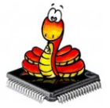


Embedded a wide range of hardware capabilities
1Kb
1Mb
1Gb
Wide range of ‘support software’:
Bare metal: libraries, but no OS
Desktop OS:
Linux
Windows
RTOS

Slide 13
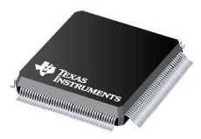
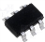
Microcontrollers
Price | E 0.30 | E 50.00
Number of I/O pins | 4 | 400
Clock frequency | 4 MHz | 400 MHz
Flash ROM | 256 instructions | 4 Mb
RAM | 16 bytes | 512 Kb
Word size | 8 | 32

Slide 14
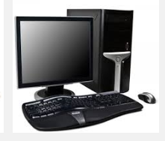
Compared with a desktop
Price | E 300 | E 0.30 | 1000 | E 50 | 6
Number of I/O pins | ? | 4 | ? | 400 | ?
Clock frequency | 3 GHz | 4 MHz | 750 | 400 MHz | 7.5
Flash ROM | 1 Tb (Hd) | 256 | 4’000’000’000 | 4 Mb | 250’000
RAM | 4 Gb | 16 b | 250’000’000 | 512 Kb | 8’000
Word size | 64 | 8 | 8 | 32 | 2
(with some rounding..)

Slide 15

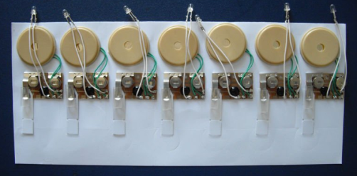

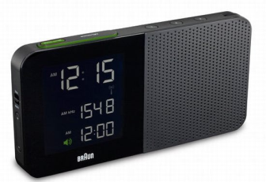
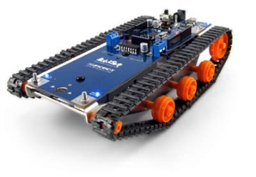

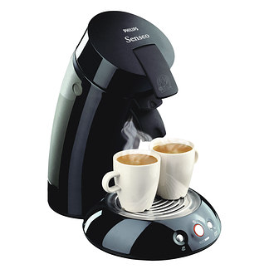

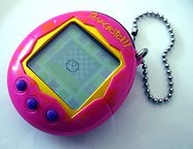
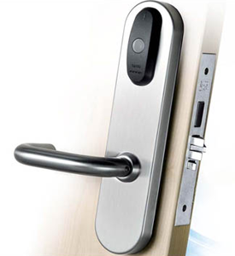
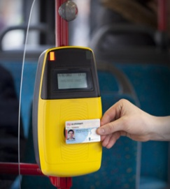
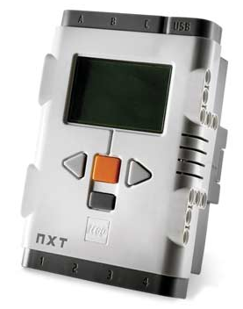
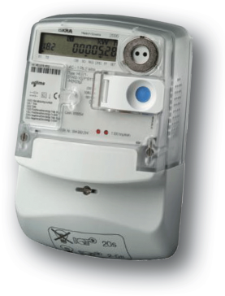
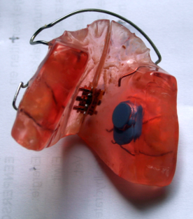
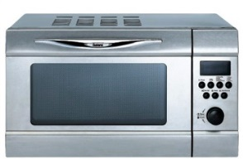
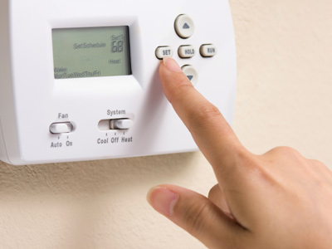

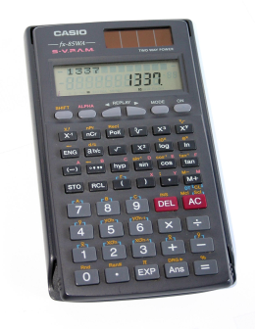
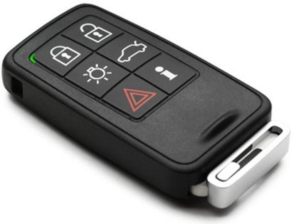
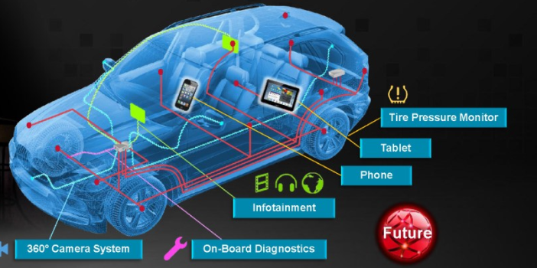
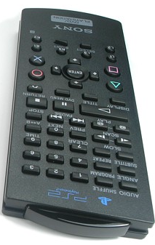
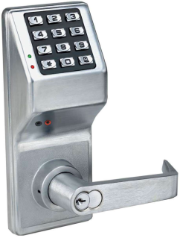
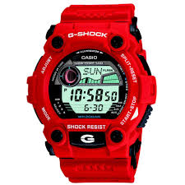

Micro-controllers are everywhere

Slide 16
Small microcontroller economics
Product cost scales with use of resources:
CPU speed (power consumption!!)
code size (Flash)
data size (RAM)
Those prices are payed by the manufacturer, not by the end user (as for desktop software).
➔ Pressure on the developers to reduce resource use: every data byte, instruction counts (even if only in the perception of the managers).

Slide 17
Small micro-controller programming
Typically
Applications are small
Volumes are high
Worst-case timing constraints must be met (average timing is generally not important)
Requirements are fixed

Slide 18
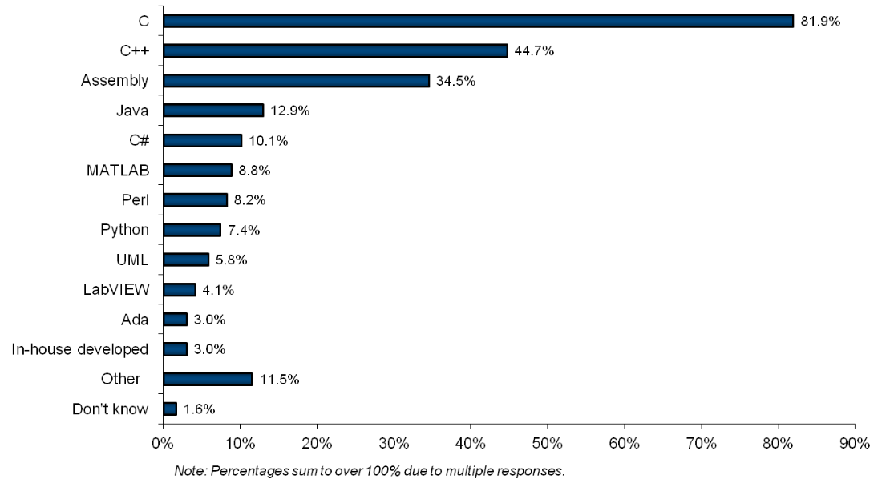
Embedded programming languages
VDC survey 2010; languages *used*, != LOC

Slide 19


Use across the spectrum
1Kb
1Mb
1Gb
C++ gap
C
Assembly
C++, C, Java, C#, Perl, Python, …

Slide 20
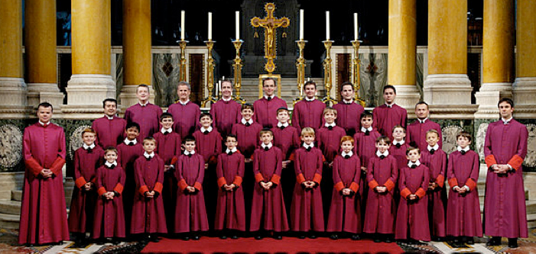
So why should C++ be used?
As a better C
(same procedural programming style, but with less room for errors)
Enables other programming styles
(OO, functional, templates, compile time, . . .)
More opportunities for (efficient) code re-use

Slide 21

But not like C++ on a desktop…
Performance is different
Heap: forget it
Floating point: often not practical
Exceptions: debatable
C++ standard library: large parts are unusable
(heap, float/double, worst-case performance)
OO at run-time (virtuals): often not needed
ROM is scarce, RAM even more so
std::ostream, std::cout ??

Slide 22
Performance
The deadline must be met
In most cases: no cache
Average performance is not interesting, worst-case is what counts
Locality is not an issue
Heap? No, thank you
Hashing, trees, rebalancing, reallocating? NO NO

Slide 23
Small applications
Often not useful on the desktop, but very useful for a small embedded application:
Single-unit application
Link-time optimization
De-virtualization
Do use -fdata-sections -ffunction-sections !!

Slide 24
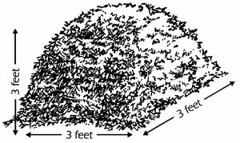
Heap
The heap is flexibility with respect to the amount of data, at the cost of (some) unpredictability in run-time and maximum available memory (fragmentation).
A typical small embedded system
has a rigidly prescribed task, including the size of the data involved
Must meet real-time constraints
Should be certain to meet work OK all the time (not just for a certain sequence of actions).
A heap and a small embedded system don’t match very well. Better:
Global allocation (!)
Fixed size pools or (better?) fixed size containers
Avoiding some dangling pointer is a nice extra.

Slide 25

Exceptions
Exceptions are great to handle a local problem that requires a (more) global response.
A small system often has a rather simple, rigidly defined task
there are no exceptions, only different situations.
No heap ➔ one reason less to use exceptions.
Exception implementation often uses the heap….
Straw man: exceptions are slow and have unpredictable timing.

Slide 26
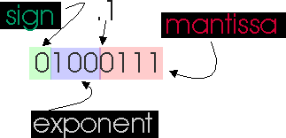
Floating point
FP is useful when a wide dynamic range is needed. For an embedded application the ranges are often very well known.
Small micro-controllers often don’t have a hardware FPU. A software FP library
Is considerably slower
Takes up ROM
Make your software ‘open’:
template< typename value_type = double >
class your_amazing_library {
. . .

Slide 27
CT versus RT
The compiler runs on a much better (faster, larger) machine.
ROM is much cheaper than RAM
➔ even more reason to do things at compile time than for a desktop application
The virtual mechanism
Is a run-time mechanism
Is an optimization barrier (but: whole-program optimziation & de-virtualization)
➔ Prefer CT-mechanisms (templates)

Slide 28
Classes & objects
Unused virtual functions are not optimized away.
Unused class data members are not optimized away.
Unused static class functions are optimized away!
Unused static class data is optimized away!
➔ Use classes as ‘compile-time managed objects’.

Slide 29
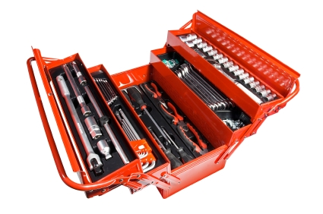
My most important C++ tools
const, constexpr, templates:
Compile-time calculations
Store in ROM, save RAM
Flexibility without Run-time overhead
RAII
overloading

Slide 30
Important C++ implementation tools
-fno-rtti
-fno-exceptions
It would be nice if your code (also) compiled with these flags.
-fdata-sections -ffunction-sections
It would be nice if your libraries were built with these flags.

Slide 31


Free licenses….
You determine the license, but be aware of the consequences.

Slide 32

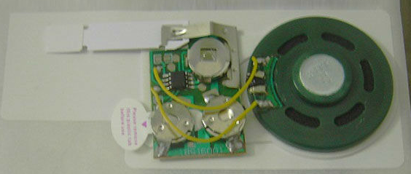
LGPL
Linking a "work that uses the Library" with the Library creates an executable that is a derivative of the Library (because it contains portions of the Library), rather than a "work that uses the library". The executable is therefore covered by this License.
You must give prominent notice with each copy of the work that the Library is used in it and that the Library and its use are covered by this License. You must supply a copy of this License. . . . Also, you must do one of these things: . . .

Slide 33

BSD 3-clause
Redistribution and use in source and binary forms, with or without modification, are permitted provided that the following conditions are met:
Redistributions of source code must retain the above copyright notice, this list of conditions and the following disclaimer.
Redistributions in binary form must reproduce the above copyright notice, this list of conditions and the following disclaimer in the documentation and/or other materials provided with the distribution.
Neither the name of the <organization> nor the names of its contributors may be used to endorse or promote products derived from this software without specific prior written permission.

Slide 34

MIT license
The above copyright notice and this permission notice shall be included in all copies or substantial portions of the Software.
Does your lawyer know whether this applies to your gadgets? I don’t.

Slide 35
Please use
You choose your license, but
If you want your code to be useable in small embedded systems, please use
Boost Software License
Zlib license
(And don’t invent yet another free license)

Slide 36

C++ implementation wish list
Wouter van Ooijen
A stack_size( N ) pragma (or function attribute or whatever) that generates an error when the function will (or might) use more than N bytes of stack space.
Warning at a called function that exceeds the limit
Error at a construct that causes compile-time-undermined stack use
Error at the pragma when the size is (possibly) exceeded, mentions the size used (if it can be determined)

Slide 37
Summary
To make your code (re-) usable on a wide range of micro-controllers
Be predictable
Don’t use the heap
Don’t use exceptions
Guarantee a (reasonable) worst-case performance
Avoid floating-point
Prefer compile-time over run-time (constexpr, templates)
Use an embedded-compatible license (boost!)

Slide 38

Management summary
Please don’t force me to use the heap.

